Slide 1
Multi-cloud Orchestration with Terraform

Slide 2
Multi-cloud Strategy - Challenges
Business Strategy
Technical Challenges
Why a multi-cloud Strategy?
Regulation
Cost Savings
Resilience
Cloud Agnostic
Uncertainties and Concerns
Complexity
Operations
Tooling
Training
Skill Set
Technical Aspects
Infrastructure
Identity
Networking
Security
Governance
Automation
Application Discovery
Decommission
Re-platform
Redesign
Rearchitect
Where to deploy?
Notes:
Identify the customer’s stage / maturity
Is the customer already using Azure or other Cloud providers
Investing in serverless / deploying
Cloud agnostic

Slide 3
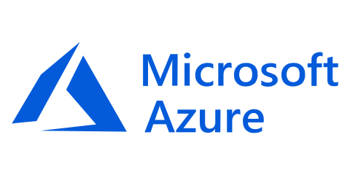
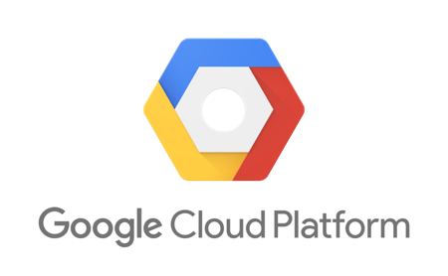




Terraform Ecosystem
Partnerships with 45+ technology providers, community support for many more
Version-control Systems
Infrastructure providers
Core
Provider
List of all 70+ providers www.terraform.io/docs/providers/
Notes:
Partnerships
VCS support

Slide 4
Prerequisites for the labs
Azure subscription (with ‘contributor rights’), or an Azure Pass or free account.
Terraform Open Source
Windows or a Linux machine
💬 Note. If you are using an Azure Free Pass then please do not activate it using your work email address. If you do then it will be unlikely that you will have RBAC permissions to create Service Principals and you will be limited to using the Azure CLI authentication.

Slide 5
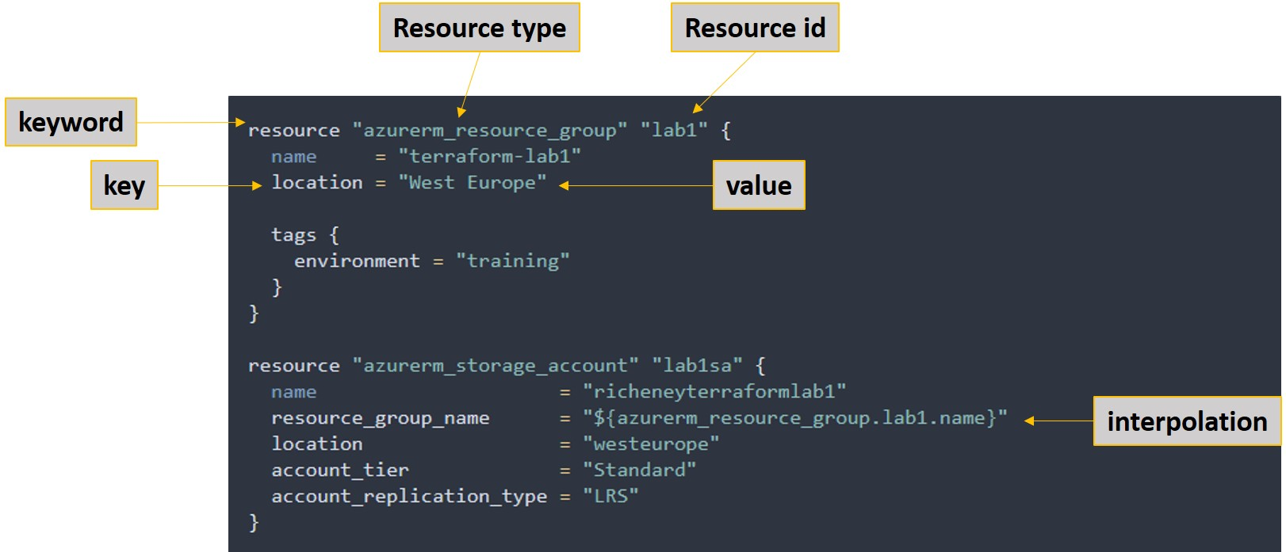
Terraform basics

Slide 6
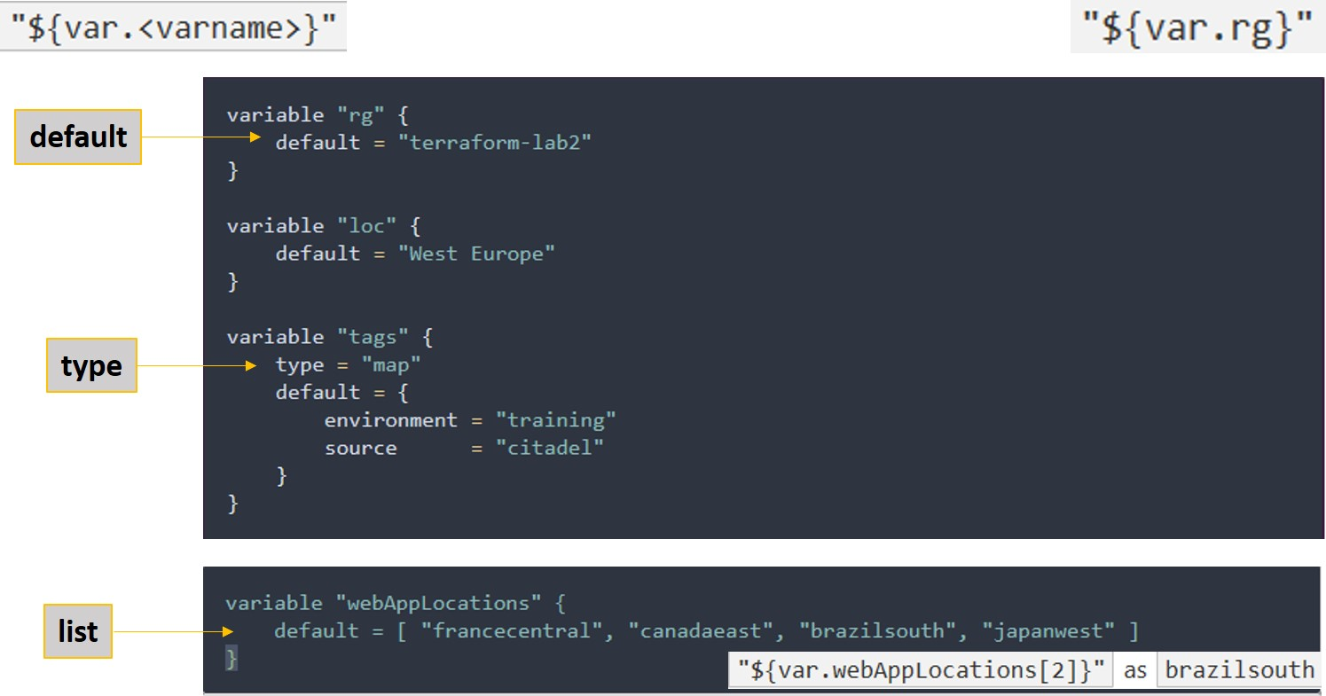
Terraform variables
Notes:
Terraform Labs: https://azurecitadel.github.io/workshops/terraform/#labs
Azure CLI: https://docs.microsoft.com/en-us/cli/azure/get-started-with-azure-cli?view=azure-cli-latest

Slide 7
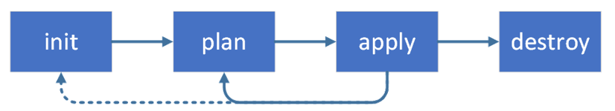
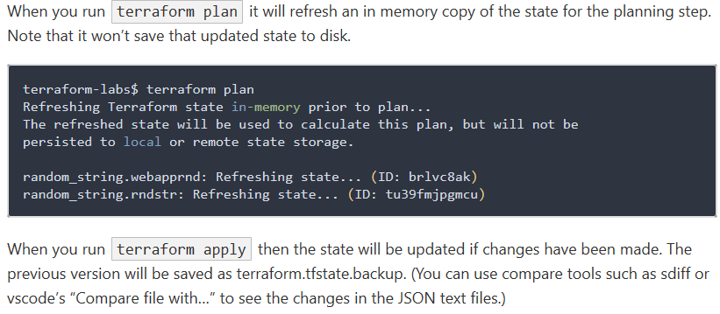
Terraform workflow
terraform init
terraform plan
terraform apply
terraform destroy

Slide 8
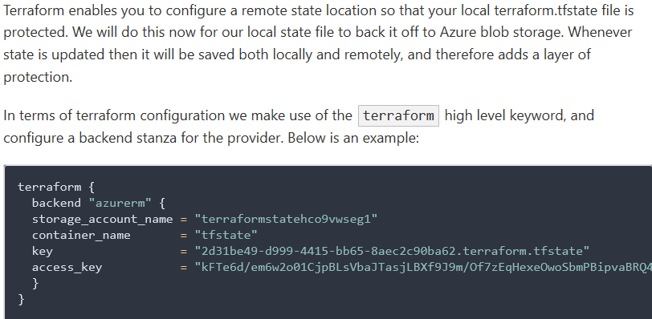
Terraform remote state

Slide 9
Challenges
Challenge 1
Challenge 3
Challenge 2
Demo
Deploying Infrastructure as Code – Lab 1 and Lab 2
Azure RG, VM, Manage Disk and VNET, NSG.
Deploying Azure PaaS – Lab 4
Azure Web App Multi-region, Azure SQL DB, NLB
Deploy Azure Kubernetes Services (AKS) – Lab 8
Terraform Enterprise - Demo

Slide 10
Challenge 1: Scenario IaaS -
Azure RG, VM, Manage Disk and VNET, NSG.
@Cenk Caglar will update this slide

Slide 11
Challenge 2: Scenario PaaS
Azure Web App Multi-region, Azure SQL DB, NLB
@Cenk Caglar will update this slide

Slide 12
Prerequisites
Azure Subscription
Terraform open source
Internet Access
Windows or Linux or Cloud Shell
List of activities required to configure Cognitive services etc.
List of activities required to configure CosmosDB
List of activities to point PBI dashboard to CosmosDB
List of activities to run end to end test

Slide 13
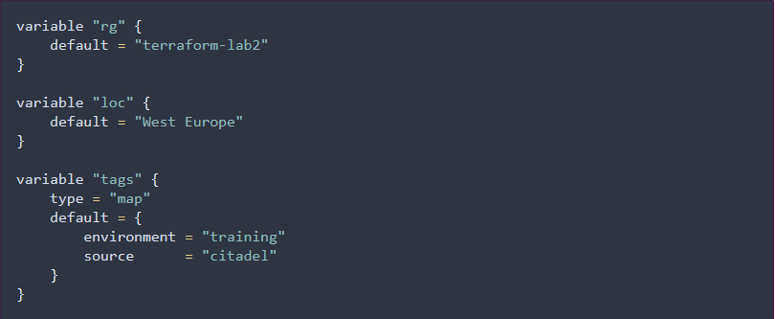

Terraform variables
default
type
list

